Slide 1



Quantum Walks & Monte Carlo Project
WISER 2025 x NNL
Team Name: Quantum Probability Pioneers
Team Members: Kazi Muktadir Ahmed, Tasfia Zaman Samiha, Asif Mohammed Saad
WISER Quantum Project

Slide 2

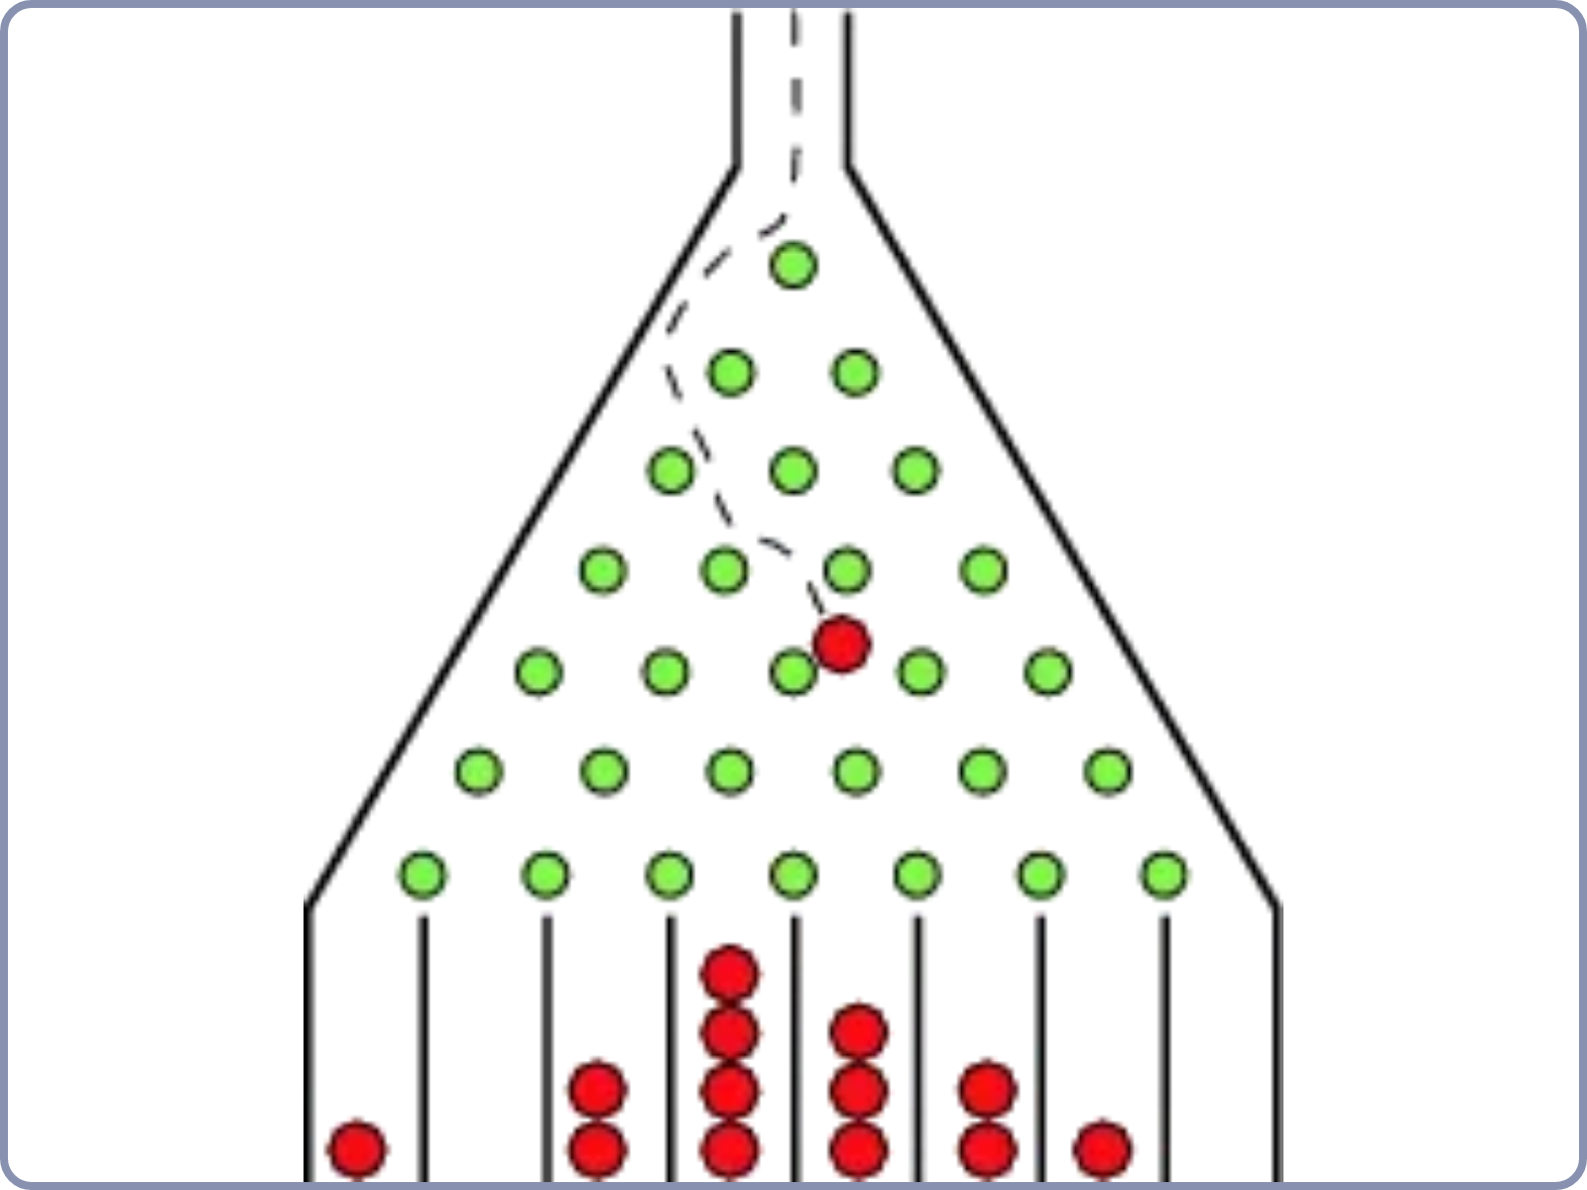
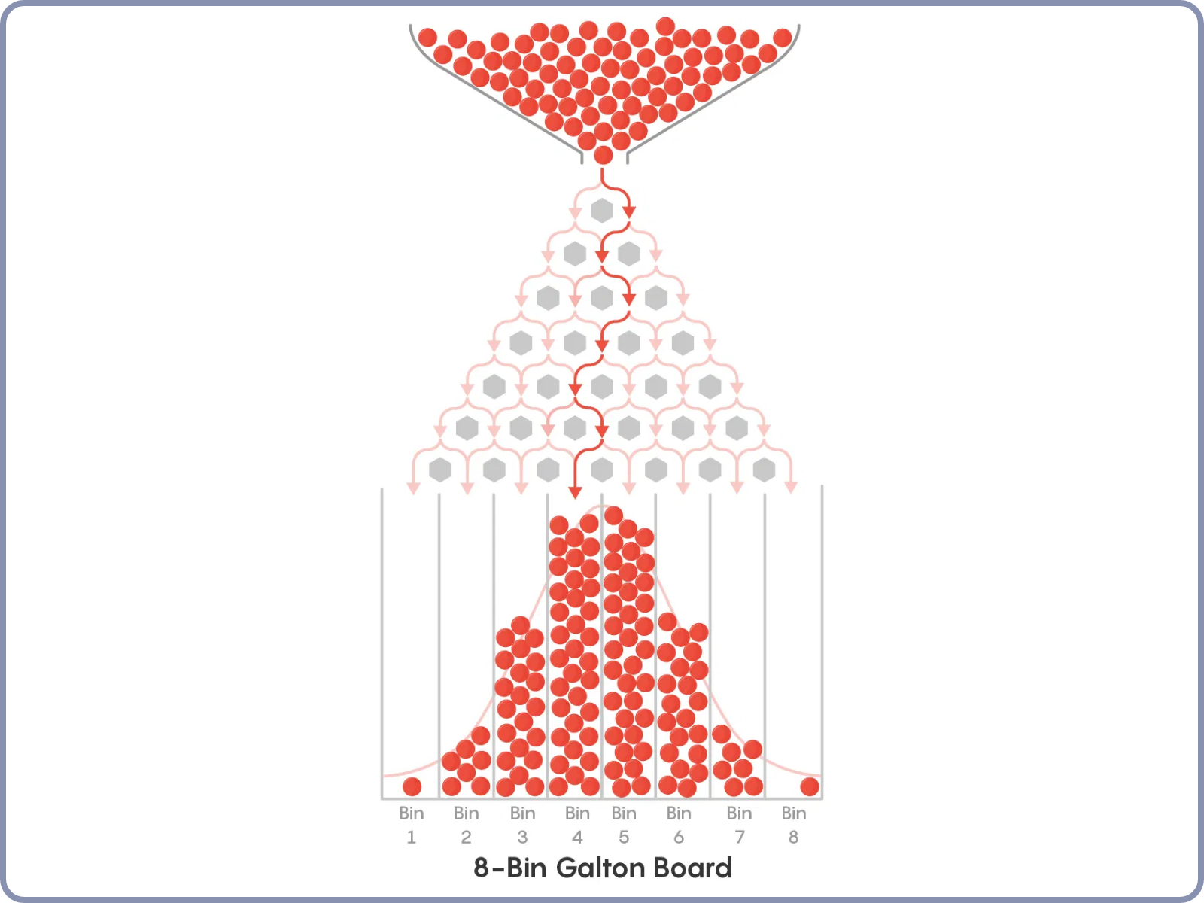
Problem Statement
This project explores how
quantum circuits can simulate complex systems
through a Galton Box-style Monte Carlo
problem.
The challenge addresses high-dimensional problems with complex interactions such as:
Particle transport simulations
Quantum systems modeling
PDE solutions for complex interactions
Based on the
Universal Statistical Simulator
, we implement quantum circuits to simulate a Galton Box (Plinko) game,
leveraging the Quantum Fourier Transform for potential exponential speed-up over classical methods.
Quantum Galton Board Simulation
Classical Galton Board Distribution
WISER Quantum Project

Slide 3

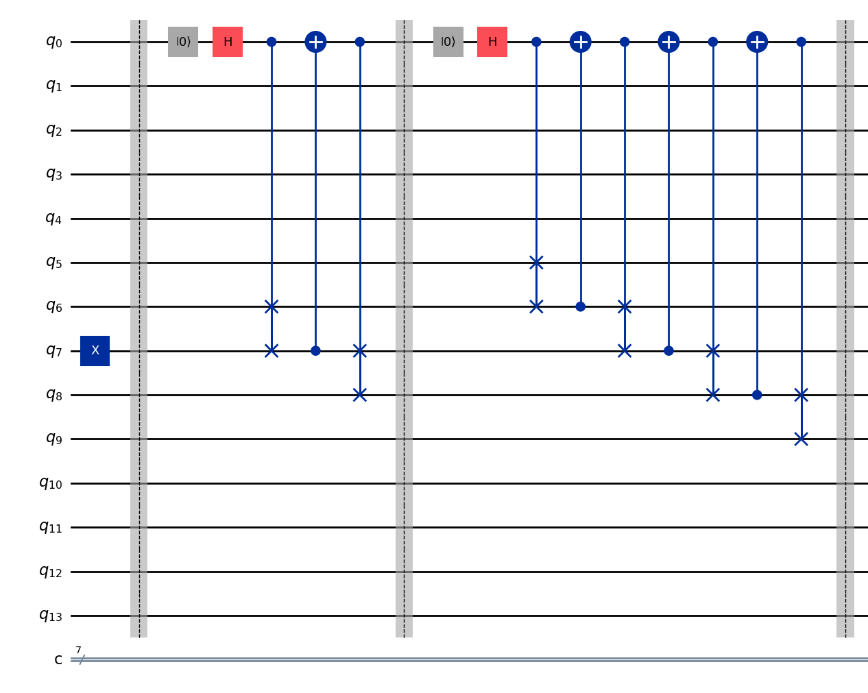
Approach & Objectives
Our approach leverages
quantum circuit design
to
simulate the Galton Box problem as a quantum walk.
Project Objectives:
Implement quantum Galton boards using quantum circuits
Create a general algorithm for any number of layers
Generate different target distributions (Gaussian, Exponential, Hadamard)
Optimize for real hardware noise models
We utilize
Qiskit
with an all-to-all sampler for noiseless
Quantum Galton Board Circuit (Partial)
quantum simulations, focusing on maximizing accuracy
and board layers.
WISER Quantum Project

Slide 4

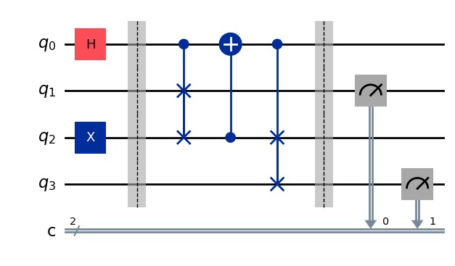

Evolution & Implementation
Our implementation evolved from basic 1-2 layer models to
a
generalized n-layer algorithm
for quantum Galton
boards.
Key implementation features:
Parameterized circuit generation for any number of layers
Modified quantum gates to achieve different distributions
Noise mitigation techniques for hardware implementation
Optimized circuits using Qiskit transpiler with optimization level 3
Quantum Peg Circuit
# Pseudocode for n-layer Galton Box
def create_quantum_galton(n_layers):
# Initialize quantum circuit
# Apply layer-specific gates
# Measure and return distribution
WISER Quantum Project

Slide 5
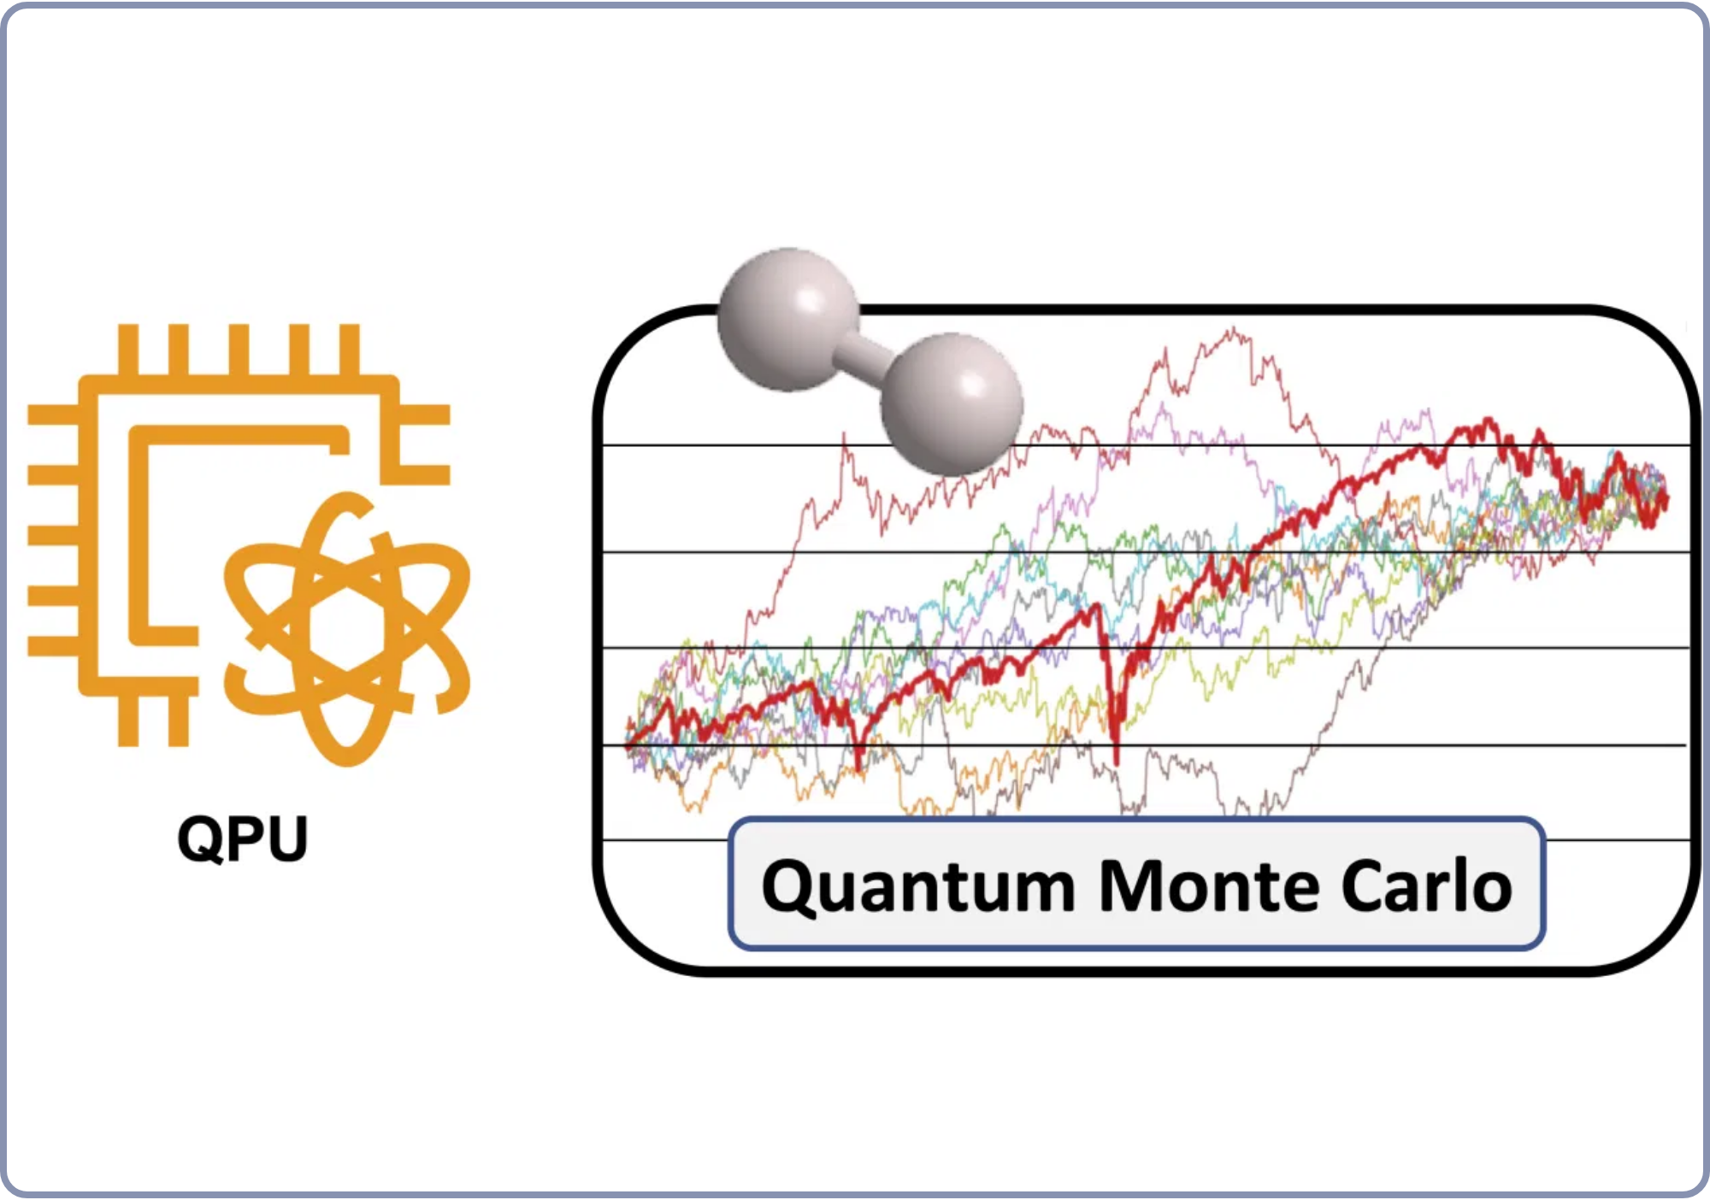
Methodology & Evaluation
We evaluated our quantum circuits on
12 different IBM
fake backends
with qubit capacities ranging from 127-156.
Evaluation Metrics:
Total Variation Distance
Jensen-Shannon Divergence
1D Wasserstein Distance
Optimization:
Qiskit transpiler with optimization level 3
Circuit depth optimization
Noise model adaptation
Quantum Monte Carlo Simulation
The
Torino backend
consistently provided the best results
across Gaussian and Hadamard distributions.
WISER Quantum Project

Slide 6

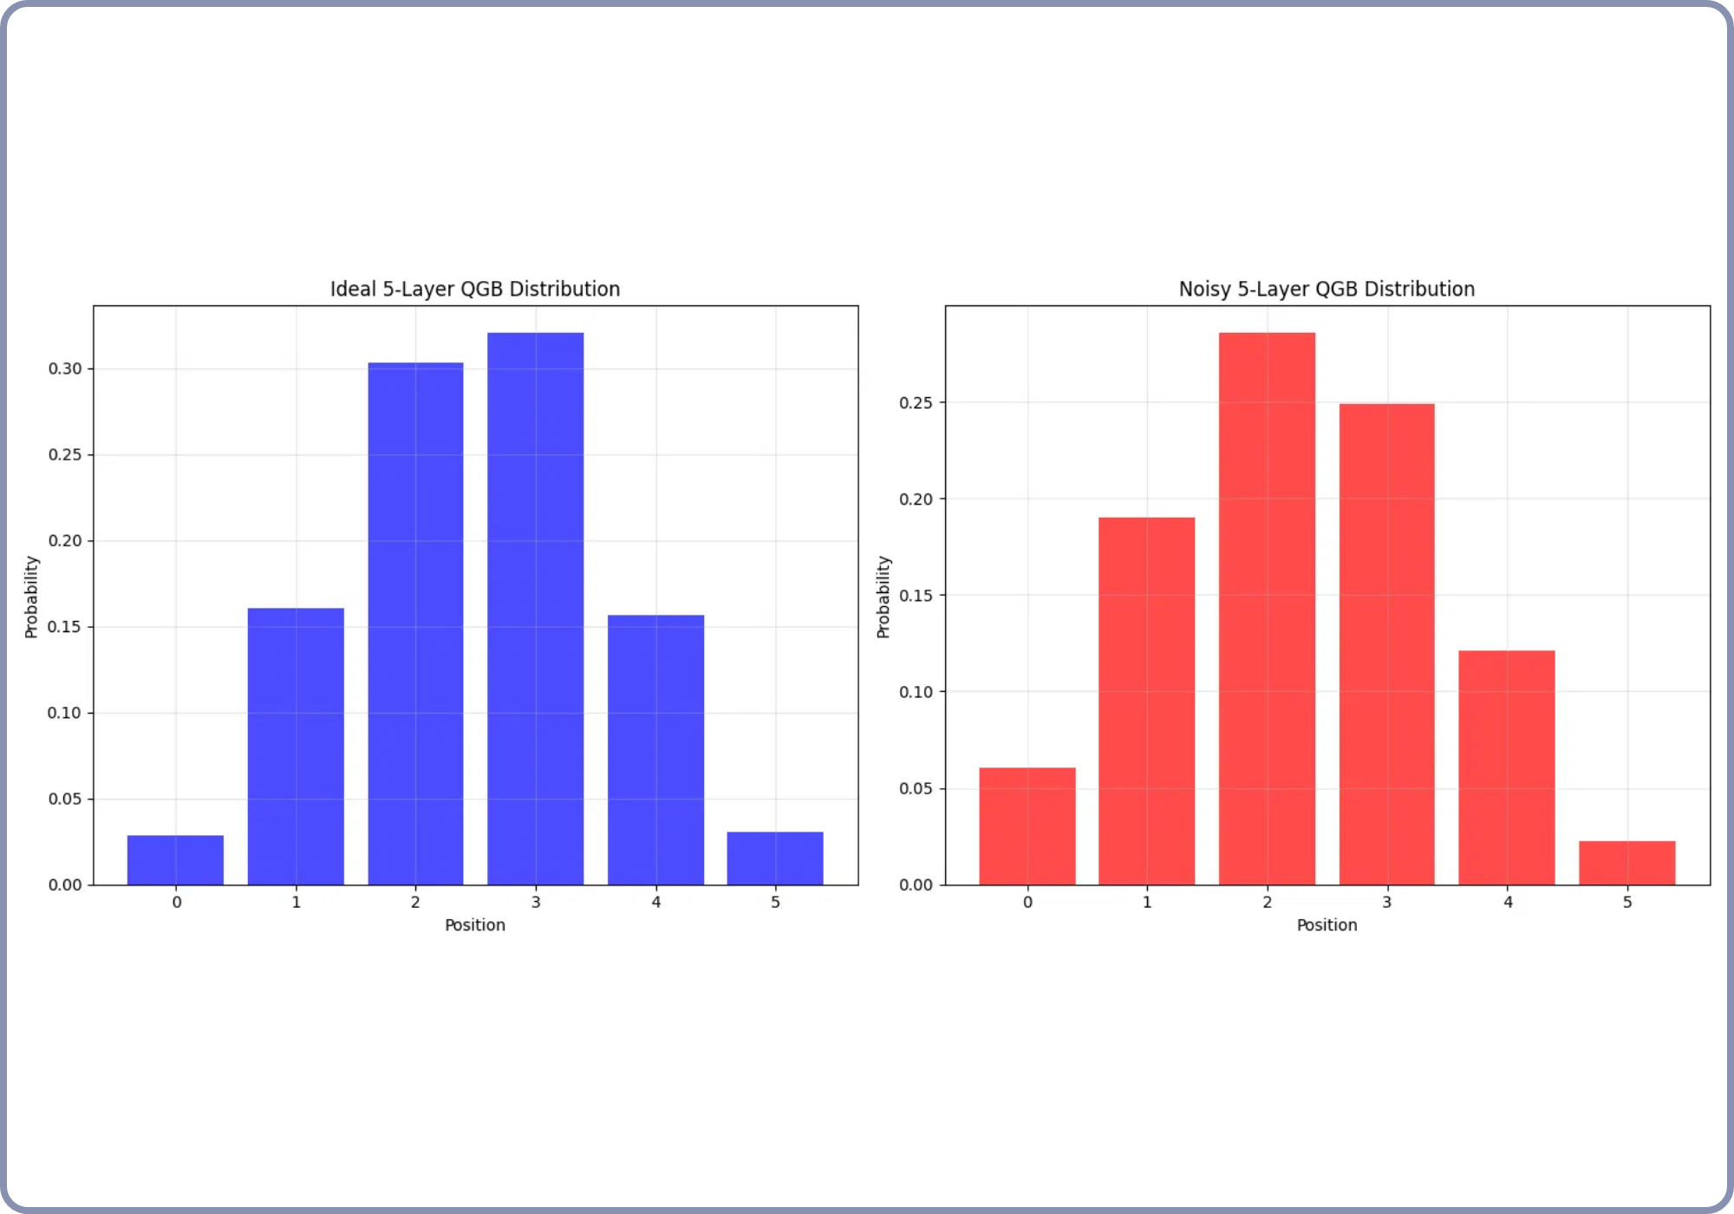
Gaussian Distribution Results (Torino Backend)
We evaluated the Gaussian distribution on various IBM
fake backends, with the
Torino backend
yielding the best
results.
The circuit was optimized using Qiskit transpiler with optimization level 3.
Metric
Value
Total Variation Distance
0.0965
Jensen-Shannon Divergence
0.1023
1D Wasserstein Distance
0.2277
Original Circuit Depth
67
Ideal vs Noisy Gaussian Distribution (Torino Backend)
Transpiled Circuit Depth
777
WISER Quantum Project

Slide 7
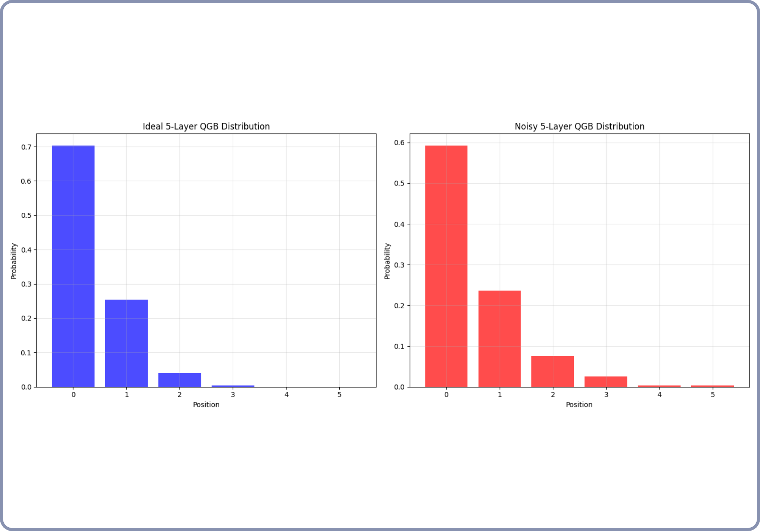
Exponential Distribution Results (Cusco Backend)
We evaluated the Exponential distribution on various IBM
fake backends, with the
Cusco backend
yielding the best
results.
The circuit was optimized using Qiskit transpiler with optimization level 3.
Metric
Value
Total Variation Distance
0.0954
Jensen-Shannon Divergence
0.1318
1D Wasserstein Distance
0.4688
Original Circuit Depth
67
Ideal vs Noisy Exponential Distribution (Cusco Backend)
Transpiled Circuit Depth
777
WISER Quantum Project

Slide 8
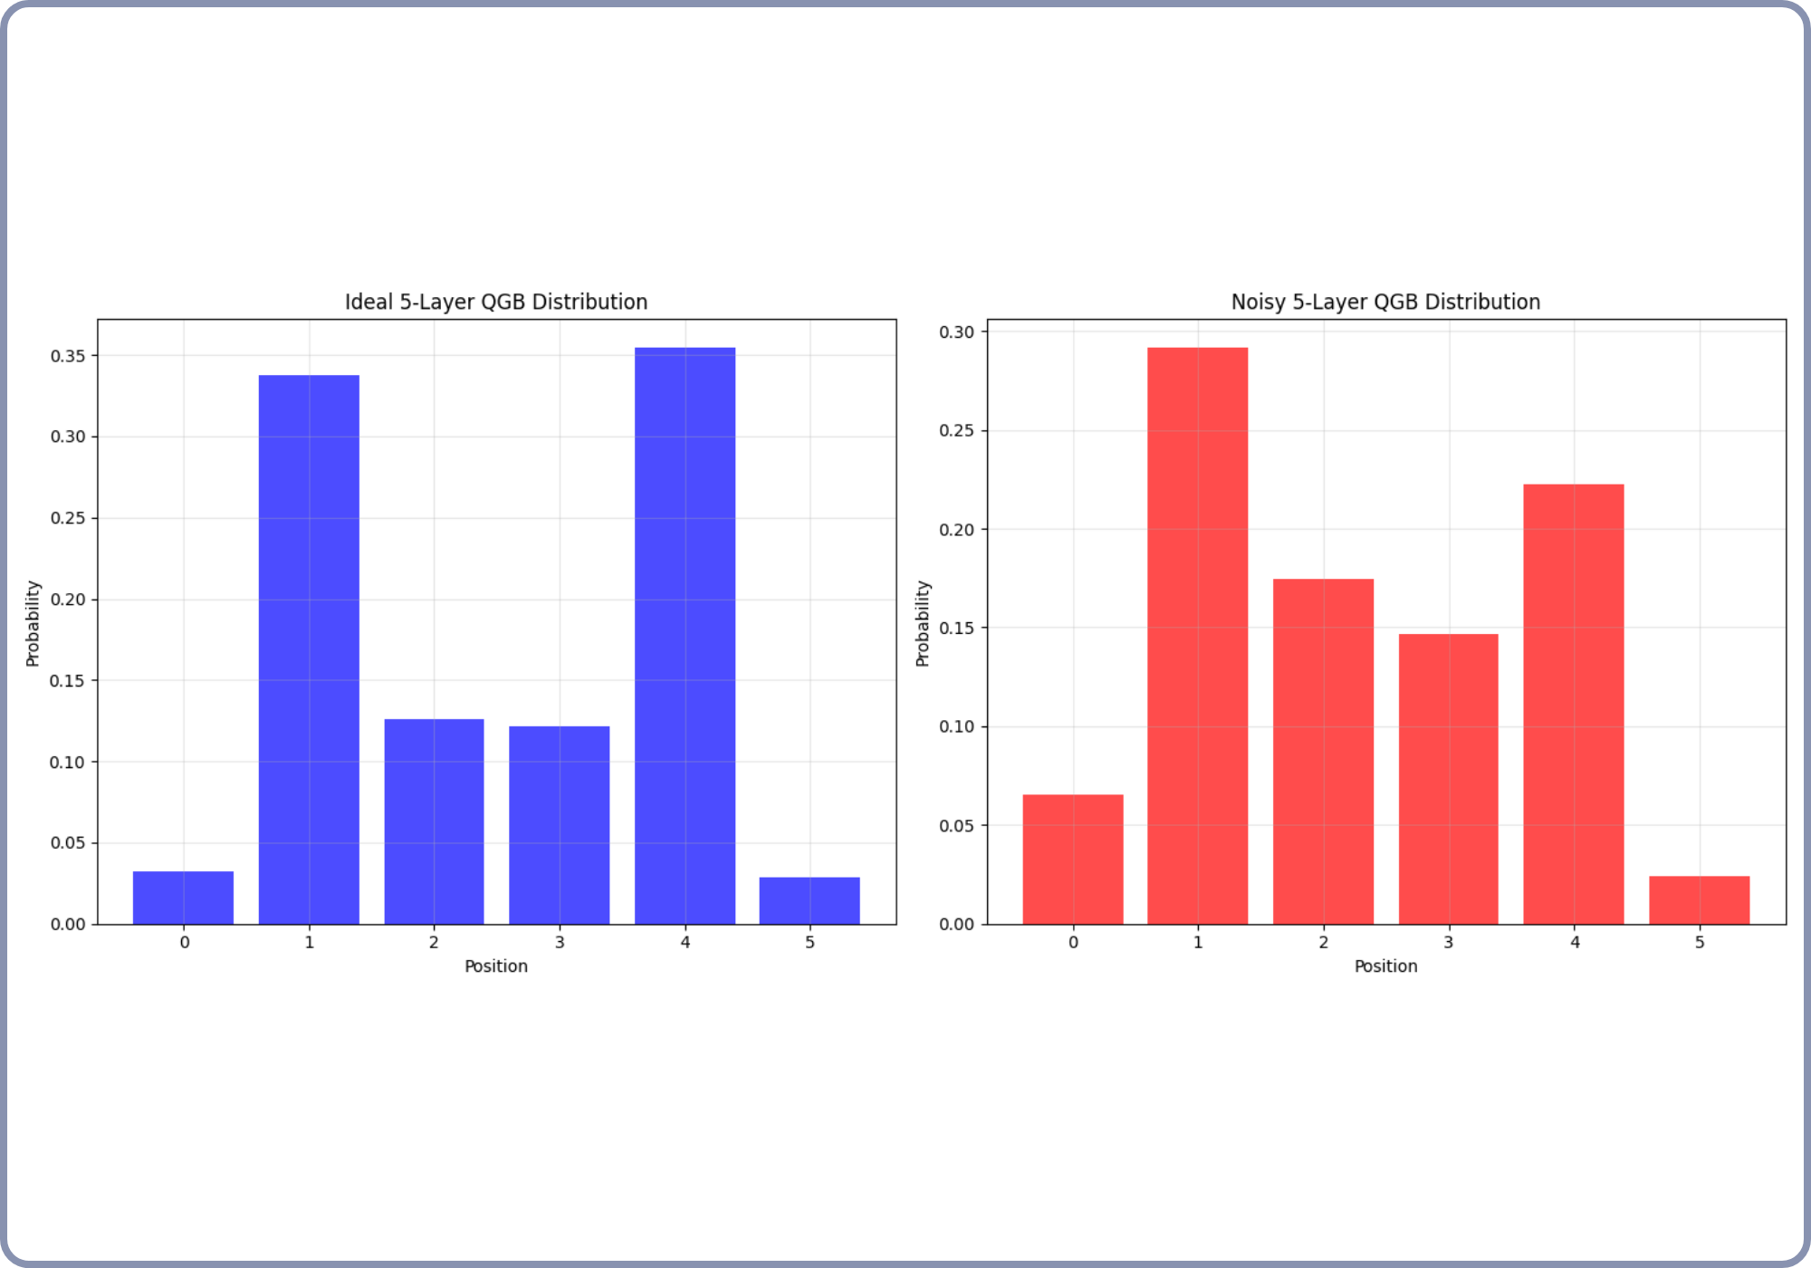
Hadamard Distribution Results (Torino Backend)
We evaluated the Hadamard distribution on various IBM
fake backends, with the
Torino backend
yielding the best
results.
The circuit was optimized using Qiskit transpiler with optimization level 3.
Metric
Value
Total Variation Distance
0.1443
Jensen-Shannon Divergence
0.1414
1D Wasserstein Distance
0.2129
Original Circuit Depth
67
Ideal vs Noisy Hadamard Distribution (Torino Backend)
Transpiled Circuit Depth
777
WISER Quantum Project

Slide 9

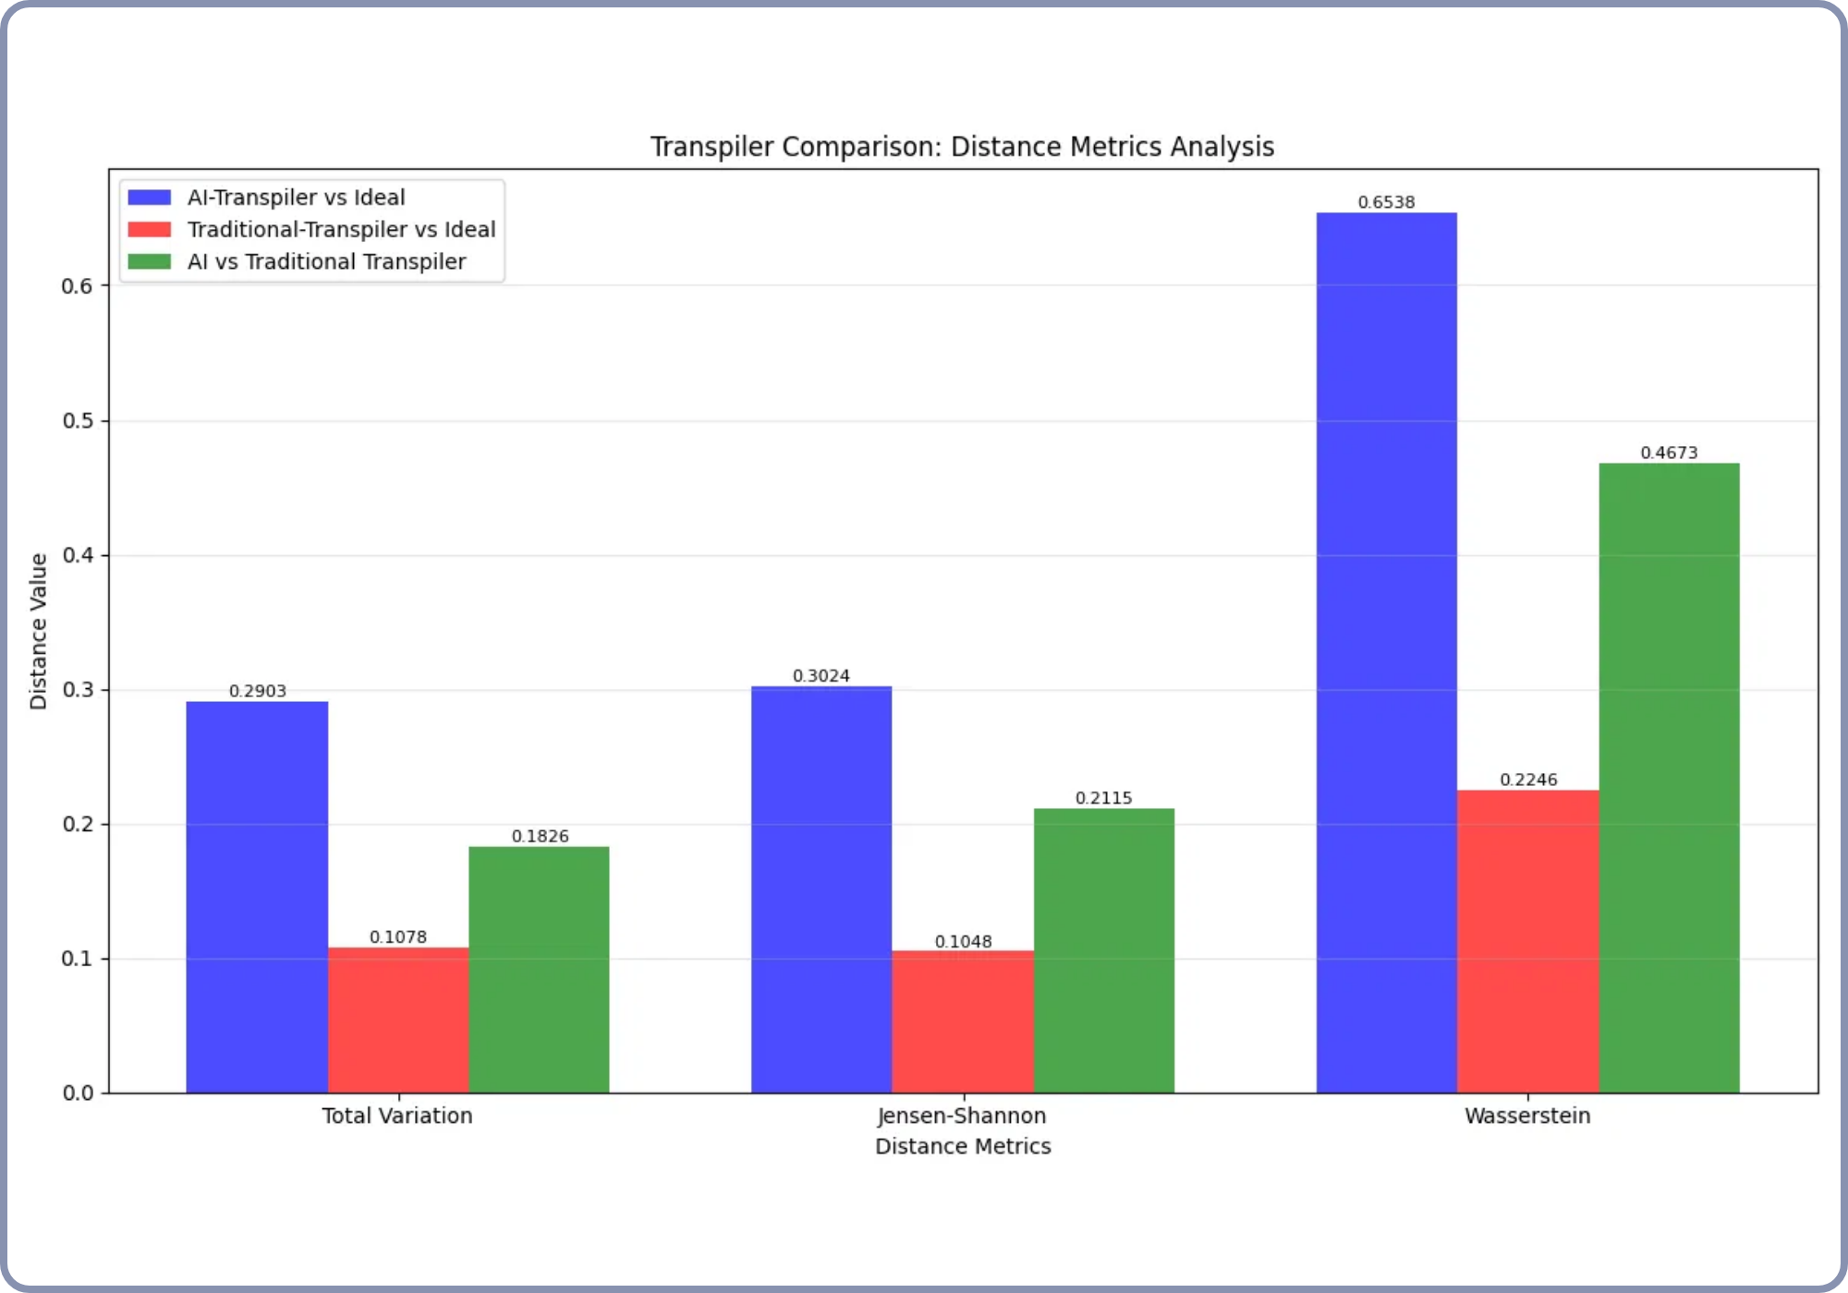
AI-Transpiler Experiment Results
We explored the impact of Qiskit's experimental
AI-
transpiler
on circuit performance for Gaussian distributions
on the Torino and Cusco backends.
Torino Backend Results
Metric
AI vs Ideal
Traditional vs Ideal
Total Variation Distance
0.2903
0.1078
Jensen-Shannon Divergence
0.3024
0.1048
The AI-transpiler did not show improvement over traditional transpilation in our experiments.
AI vs. Traditional Transpiler Performance
WISER Quantum Project

Slide 10
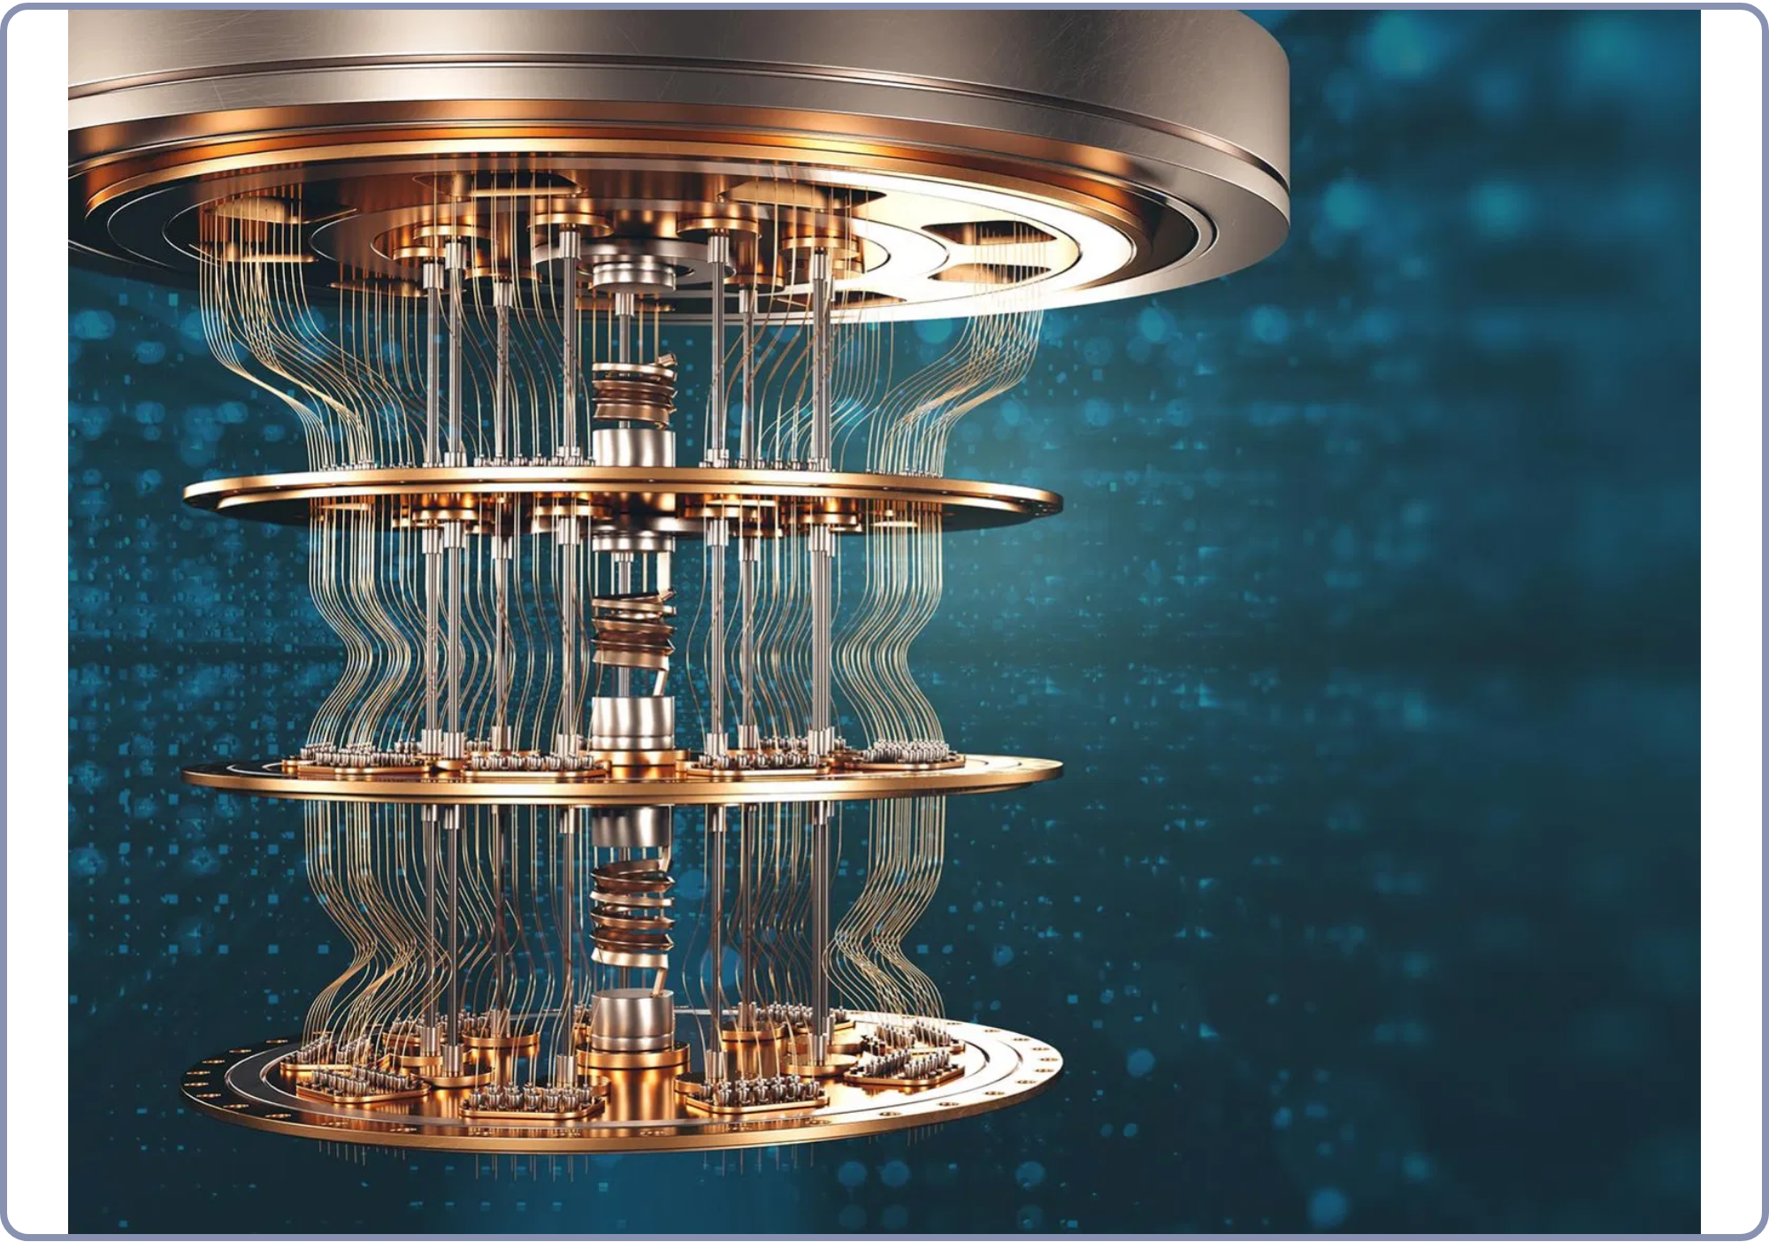


Future Scope
Building on our current implementation, several promising directions for future work include:
Extensions
Limitations
Higher-dimensional quantum walks
Circuit depth (current: 46)
Integration with quantum machine learning
Coupling map constraints
Noise impact on distribution fidelity
Application to specific PDE problems
To advance further, we would need
improved error
Broader Context of Quantum Walks Research
correction techniques
and
higher qubit connectivity
in
quantum hardware.
WISER Quantum Project

Slide 11
Thank You
Quantum Walks & Monte Carlo Project
Team: Quantum Probability Pioneers
Kazi Muktadir Ahmed,
Tasfia Zaman Samiha,
Asif Mohammed Saad
GitHub:
https://github.com/KaziMuktadirAhmed/WISER-womenium-2025-project-1
Contact: kazisujoy@gmail.com
WISER Quantum Project

